Slide 1
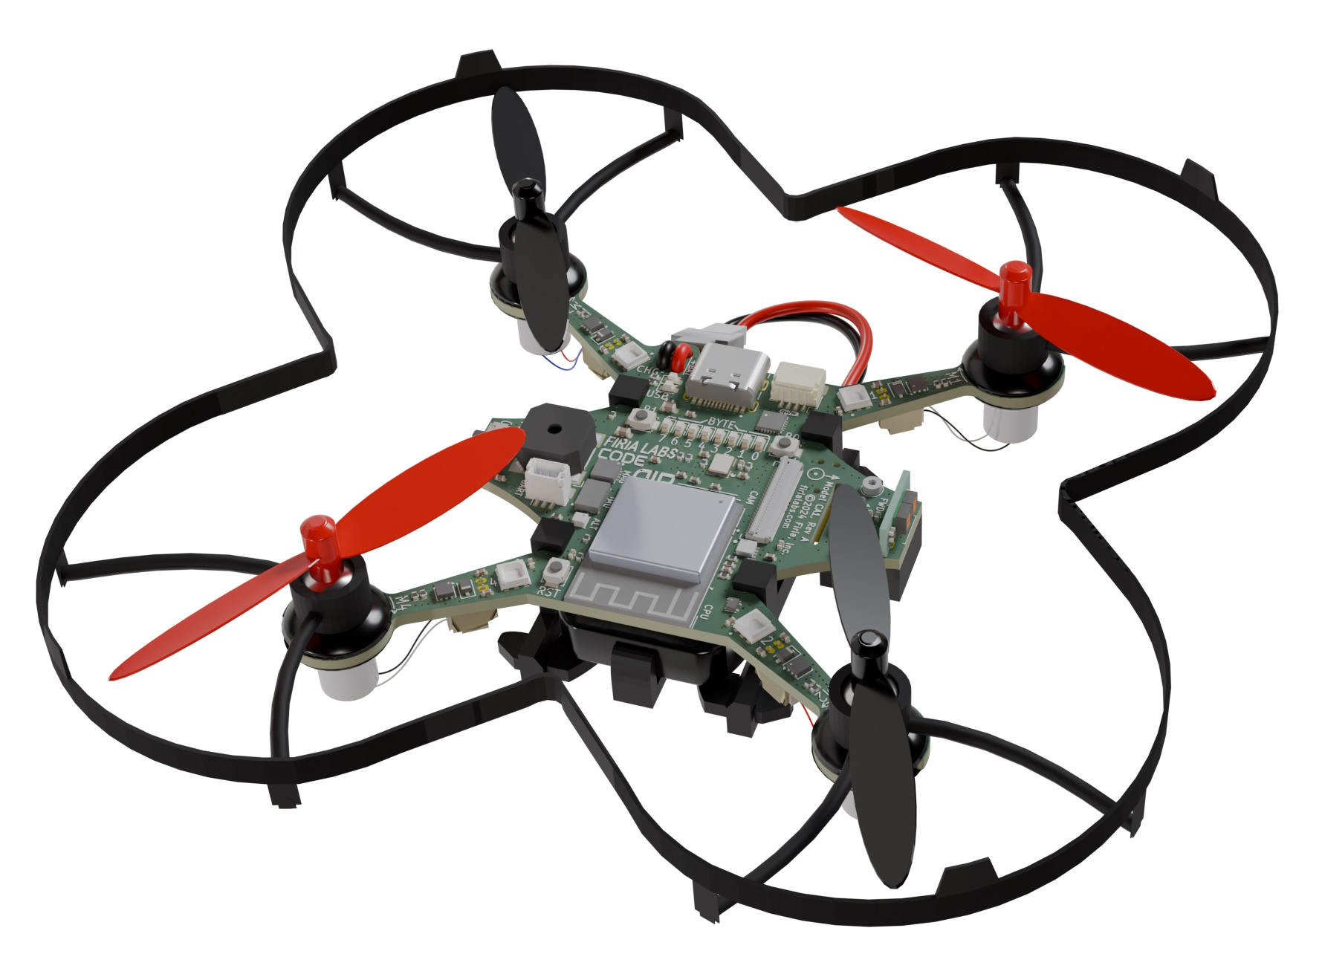
CodeAIR Unit 1 Remix
Create your own project based on Missions 2 and 3

Slide 2
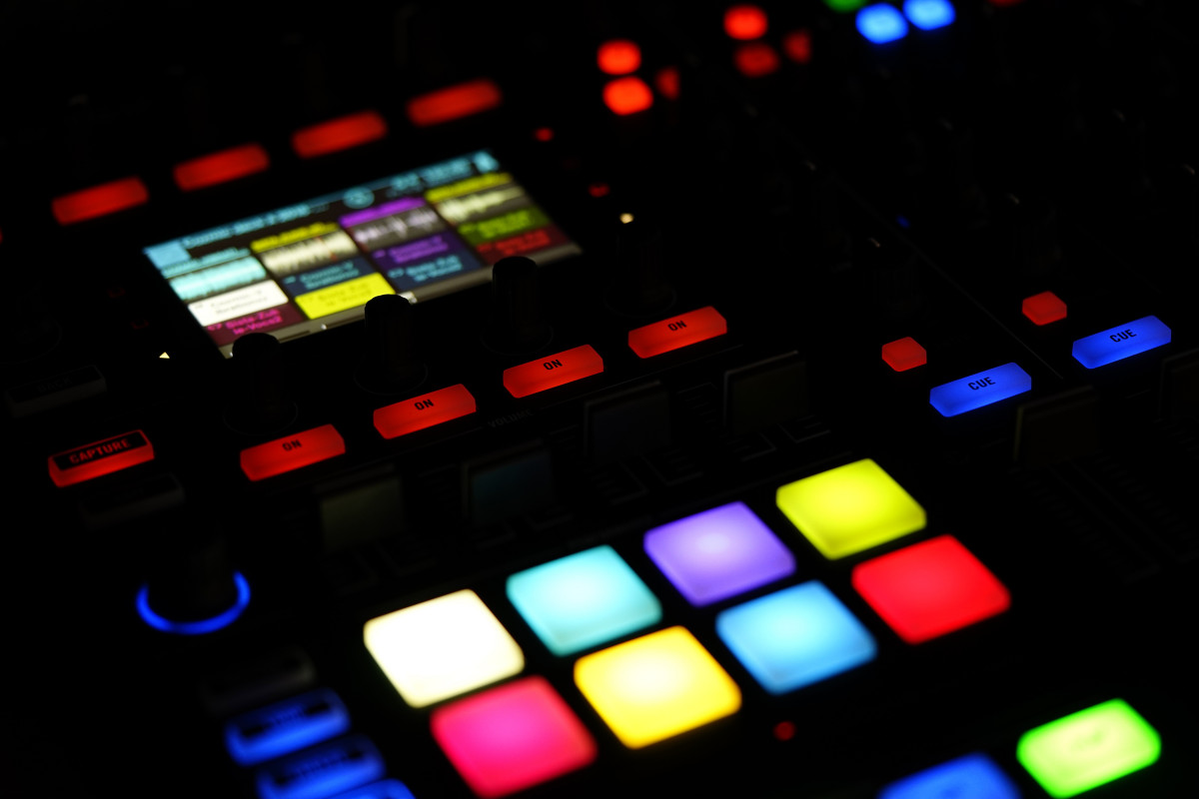
Time for a project remix!
A remix can be:
A new program created by adding new code to a program you already created
You can combine parts of two or more programs in a remix
Use a similar idea in a different way

Slide 3
Project Remix
Creating a remix will let you:
Improve your skills and practice the concepts from the mission
Be creative
Remember code from earlier programs and missions
Work with other students
Design an original program and write the code all on your own

Slide 4
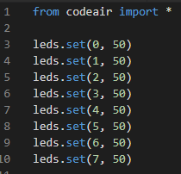
Step #1
Review Mission 2
Open your program from
Mission 2
  What does the program do?
  What skills were used or concepts learned?
DO THIS:
Fill out the information in the Planning Guide for Step 1

Slide 5
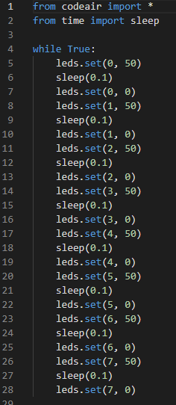
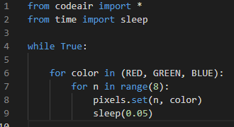
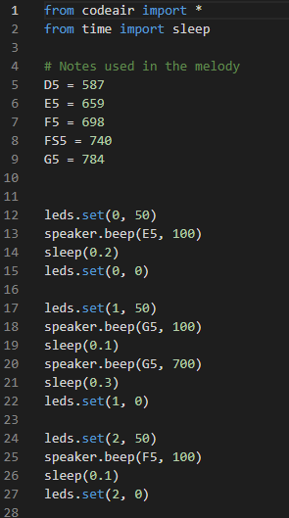
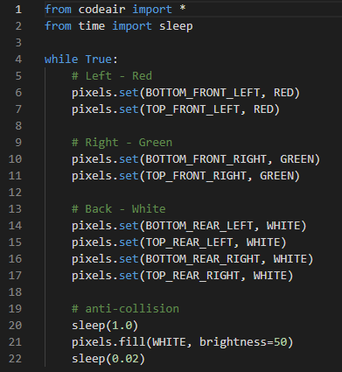
Step #1
Review Mission 3
Open your programs from
Mission 3
  CylcleLEDs
  Melody
  SkyLights
  RunningLights
DO THIS:
Fill out the information in the Planning Guide for Step 1
  What do the programs do?
  What skills were used or concepts learned?

Slide 6
Step #2
Brainstorm ideas
Review the extensions from each mission. Apply an idea from the extension to a different setting.
Read through remix suggestions on the following slides.
You can use any of these ideas or come up with your own.

Slide 7
Step #2 Remix Ideas
Mission Extensions
Mission 2: Use the blue LEDs to display a pattern by either turning some lights on and keeping some off, or using different levels of brightness.
Mission 3: Use the blue LEDs and pixel LEDs to display a light show. Add music.

Slide 8
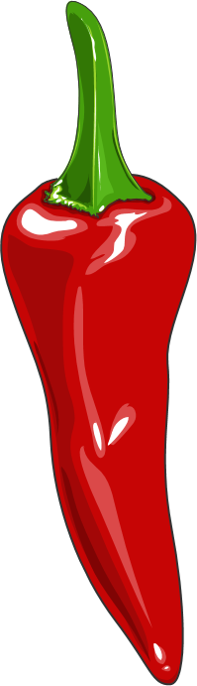
Step #2 Remix Ideas
Mild
Cycle through all the blue LEDs and then the pixel LEDs. At the end of each cycle, play some notes.
Medium
Play a song, and light up an LED with each note. Use the blue and pixel LEDs. For more of a challenge, use the same light with the same note each time it is played.

Slide 9
Step #2 Remix Ideas
Spicy
Create a 2-3 minute light show. Light up the blue and pixel LEDs with different brightness or colors with timing to last 2 to 3 minutes. Add in sound either between light displays or during light displays.
Spicy
Create a fireworks display. Use the blue LEDs as the fuses, and play sounds during the burning. Then use the LEDs to simulate fireworks in the sky. Add more sounds for the fireworks.

Slide 10
Step #2
Brainstorm ideas
Read through remix suggestions
Use the suggestions –or–
Use your creativity to come up with your own idea for a project
Decide with your partner what project you will do
DO THIS:
Fill out the information in the Planning Guide for Step #2

Slide 11
Step #3
Make a plan
What variables will you need? What will you use them for?
What constants will you need? What will you use them for?
How will you control the blue LEDs?
How will you control the pixel LEDs?
How will you incorporate sounds?
DO THIS:
Fill out the information in the Planning Guide for Step #3
  Add to the Planning Guide with more information, as needed

Slide 12

Step #4
Code your project
IMPORTANT: In CodeSpace, go to the sandbox
Start with a new file and give it a descriptive name (Remix1)
You can leave any program open and use it as a guide
Import your modules
Define your variables and constants
Write your code, testing frequently

Slide 13
Step #4
Stop and test frequently!
Don’t try to write all the code at one time
Think about the steps:
  Just get one thing to work, then move on
  Step by step!
Mistakes happen, so find them early
Type just a few lines of code and then run the program
If there is an error, fix it before continuing
Use your other programs and classmates for help

Slide 14
Step #5
Documentation!
Make sure your code is readable by adding blank lines
Add comments to sections of your code that explain what they do

Slide 15
Step #5
Get feedback
Show your code to other students.
What do they think? Have them fill out the feedback form on your Planning Guide.
The Planning Guide has space for two people to give feedback. The feedback can come from two peers or one peer and yourself.
Use the peer reviews to modify your code and make your project even better

Slide 16

And now you have your own remix!
Congratulations!
By completing this remix you have:
learned more about programming
practiced the skills and concepts from the missions
been thinking! And problem solving and much more!

Slide 17

Mission Reflection
Wow! Great job!
Share your project with your friends!
Run projects from other students
Complete the Reflection in the Planning Guide

